Slide 1
Text Mining 1
Brock Tibert
btibert@bu.edu

Slide 2
Outline
Homework and Exam Discussion
Text Mining - Working with Text as a Data Source
Hands-on in python
In-class Group Data Challenge - Classify SMS messages!

Slide 3
First Half Discussion

Slide 4
Text Analytics
^[\w-\.]+@([\w-]+\.)+[\w-]{2,4}$
Notes:
Generic email regex
https://stackoverflow.com/questions/201323/how-to-validate-an-email-address-using-a-regular-expression

Slide 5
Why Text Mining?
80-90% of all corporate data is in some kind of unstructured form (e.g. text)
Benefits of text mining are (or will be) obvious especially in text-rich data environments
Email and spam filtering
Law (Court-orders)
Financial Disclosures
Medicine (discharge summaries, doctor notes)
Marketing (Customer comments and reviews)
Customer Support (In-bound help, problems with ordering, FAQs, etc.)
Survey research and analysis of open-ended results
Content Management

Slide 6
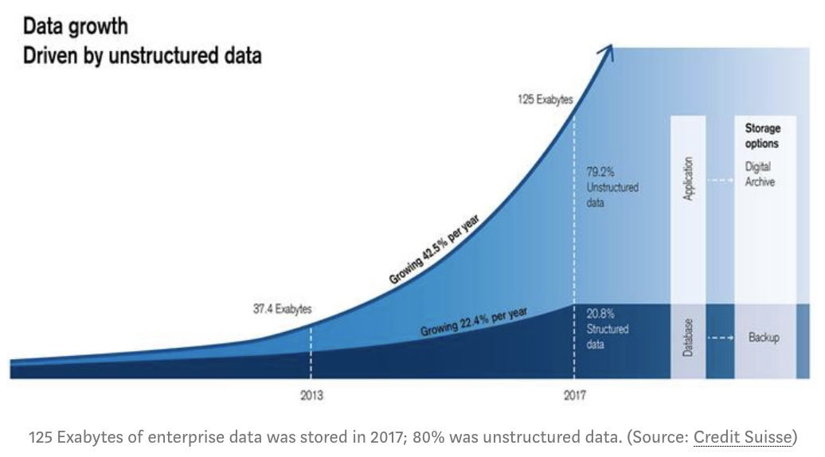
Notes:
Image source: https://www.kdnuggets.com/2019/10/data-scientist-data-management.html

Slide 7
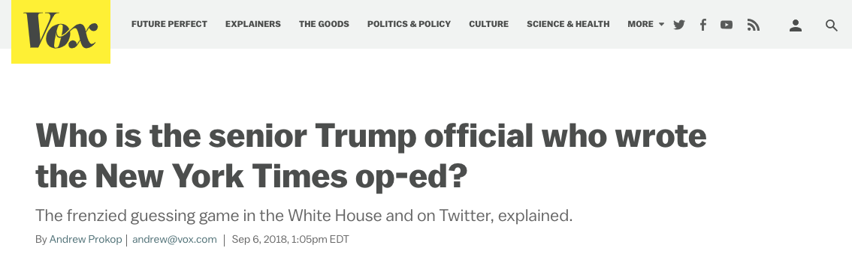
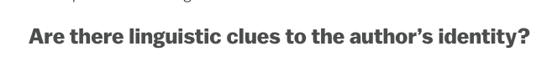

Slide 8

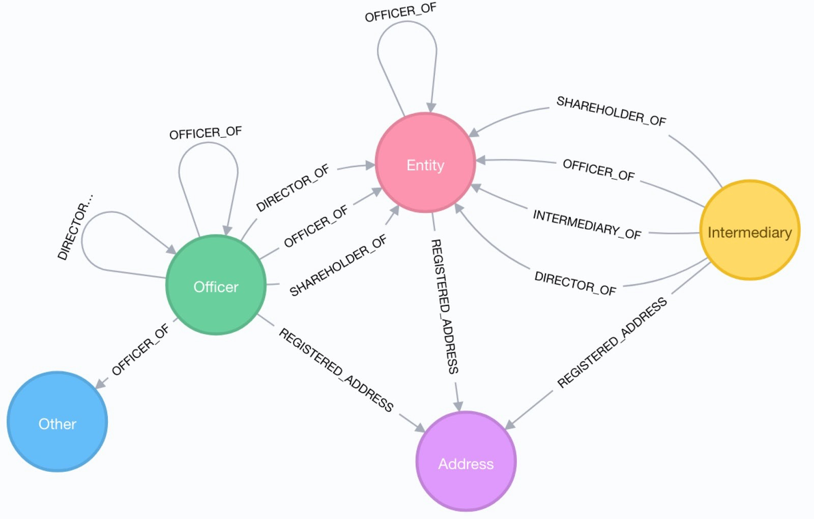
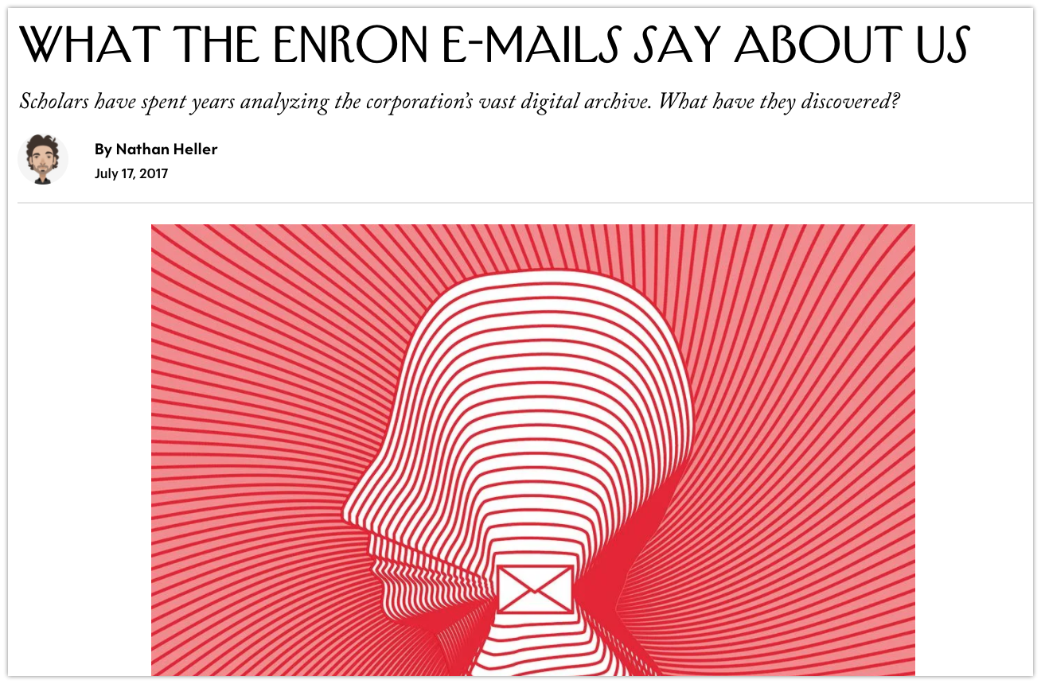

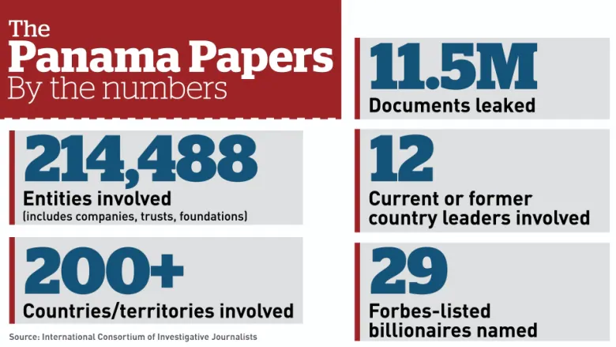
Notes:
https://www.newyorker.com/magazine/2017/07/24/what-the-enron-e-mails-say-about-us

Slide 9
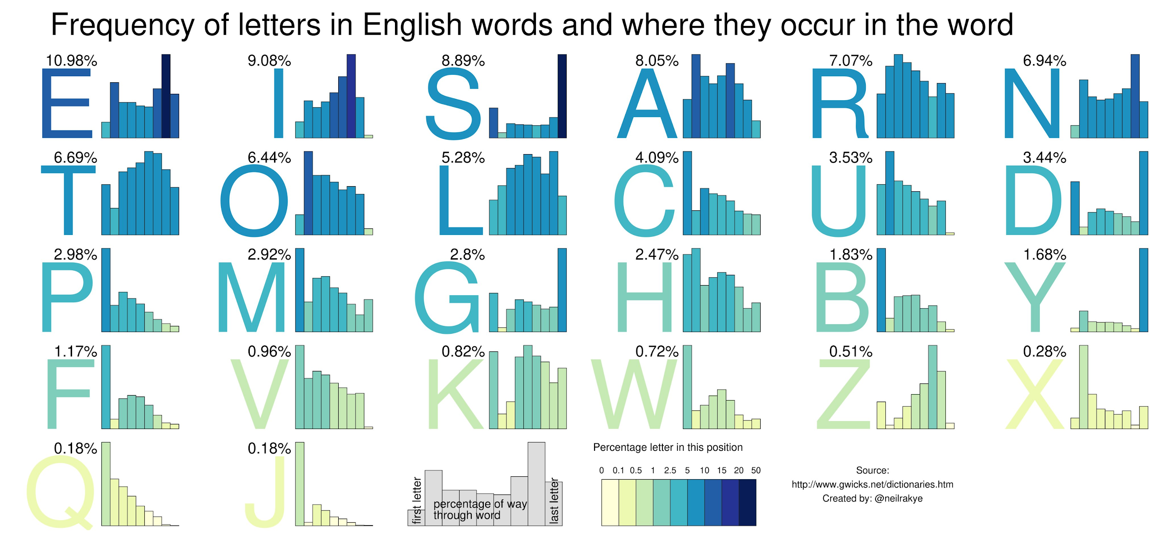
Notes:
https://twitter.com/neilrkaye/status/1363417255812493314/photo/1

Slide 10
Objectives
Pattern Discovery (Unsupervised Learning)
Prediction (Supervised Learning)
These are the same goals for all of the tasks we have covered in in the program. It’s just about putting the data together properly, for our need.
Data acquisition, cleaning, reshaping, compression
In addition, text mining can be applied to look “inside” a document to:
Identify targets of positive/negative sentiments
Predict the intent
Extract entities and relationships
Identify the level of complexity in a document
E.g. Find the proper educational material for children

Slide 11
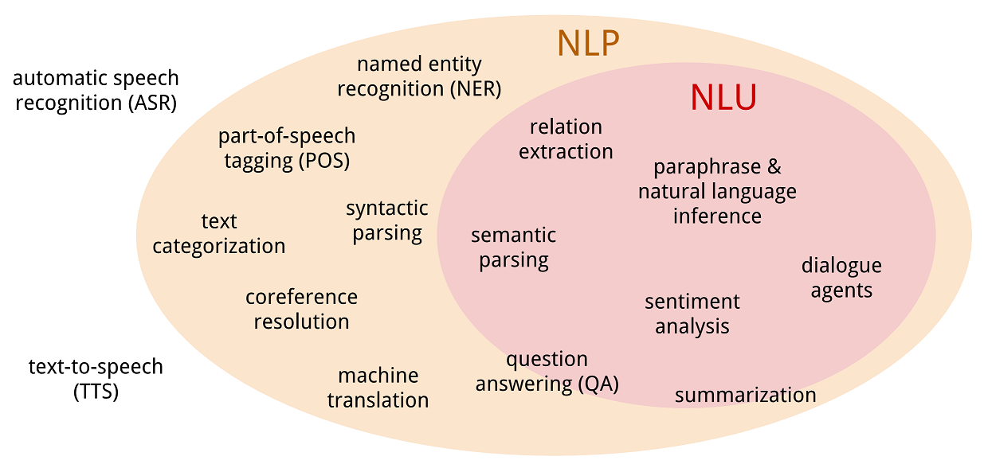
Notes:
Image Source: https://devopedia.org/natural-language-processing

Slide 12
Text Mining Setup
Data Mining techniques allow us to combine natural language processing with ML methods in order to identify patterns and make predictions
All the classification and clustering techniques we have discussed are applicable, as soon as we transfer and parse the data into a familiar row-column format.
This is the format we will mostly focus on for our text work
There is a highly active community in python when it comes to building tools to work with text as a datasource. Unfortunately it’s not as well as concentrated as there are “competing” projects that put their spin on core tasks and work.
variations of the same theme

Slide 13
Toolkits in python (an abbreviated list!)
nltk | sckit-learn | gensim | spacy | newspaper3k | TextBlob
coreNLP | pattern | PyNLPI | Monkeylearn | rasa | vaderSentiment
emoji | wordcloud | Vocabulary | Quepy | flair | AllenNLP
Transformers | fasttext | Tensorflow Text | pyLDAviz | OpenNLP | fastAI
graphBrain | polyglot | pyTextRank | stop-words | tokenwiser | textacy
What makes this more interesting is that the packages depend on each other. Simply, some packages use other packages in the background.

Slide 14
Toolkits in R (an abbreviated list!)
tm | tidytext | quanteda | udpipe | stm | topicmodels
textfeatures | Crfsuite | sentimentr | stopwords | tokenizers | cleanNLP
openNLP | textclean | textstem | textrecipes | wactor | text2vec
textmineR | ruimtehol | btm | qdap | rake | lexicon
readtext | spelling | hunspell | meanr | wordword | wordVectors
In case you are inteRested in R

Slide 15











Data Sources

Slide 16
(Higher Level) Definitions
Corpus: A collection of documents is a corpus
Document: An individual text composed of tokens. A document could be a tweet, a book, a news article, a blog post, a song’s lyrics, customer support request, a financial disclosure …
Token: A token is a contiguous set of characters that does not contain a separator
In other contexts, can be N-grams, or a sequence of tokens (golf club)
Separator: How do we define breaks between tokens? Whitespace? Punctuation? Every character?

Slide 17
Example - Document Term Matrix Construction
The collection of sentences is the corpus
Each sentence is the document
Each word boundary is the token
Each value is the simple term count, or occurrence
Various python packages construct these, with slight differences
Sentence | hockey | ftw | i | like | golf
I like golf! |  |  | 1 | 1 | 1
I like hockey. | 1 |  | 1 | 1
Hockey and golf ftw | 1 | 1 |  |  | 1

Slide 18
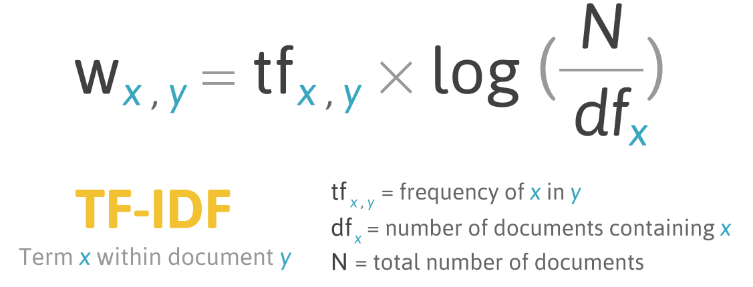
Text Mining Process - Word inclusion and weighting
Create the Document-Term Matrix (also seen noted as: DTM, TDM, DFM)
Should all terms (N-grams) be included?
Stopwords
Stemming/Lemmatization
What is the best representation of values in the cells?
Raw counts/frequencies? Binary values? Log of the counts?
Inverse document frequency
Notes:
Image source: https://mropengate.blogspot.com/2016/04/tf-idf-in-r-language.html
homonyms : bank (river bank, institution, as into bank the ball of the wall), bark (tree, dog)

Slide 19
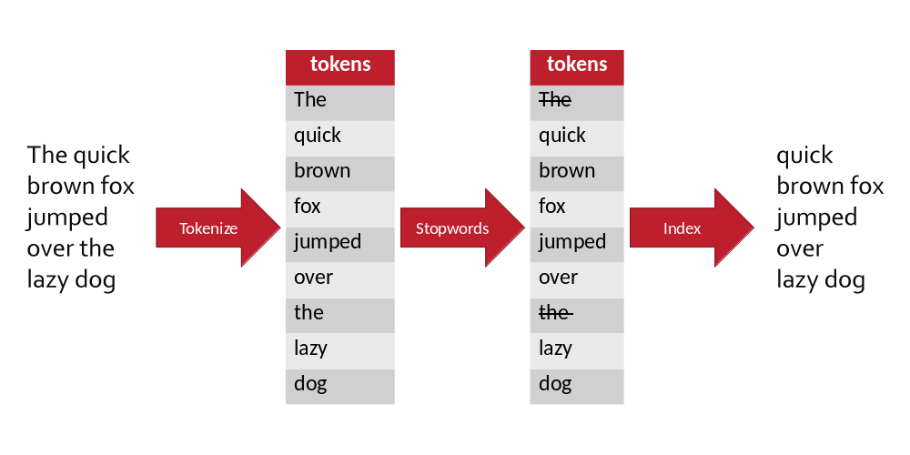
Compiling the Dictionary: Stop/Rare Words
Remove domain-specific Stopwords
Common words are typically removed as well, but it’s always good to review the stopwords for domain-specific projects
Also want to consider removing extremely rare and frequent words
Either too rare it won’t add value
Too common, it just adds noise
Notes:
Image source: https://www.eyerys.com/articles/how-stop-words-can-affect-your-seo-and-also-revenue-if-you-are-publisher

Slide 20
The Vocabulary: Stemming & Lemmatization
In order to reduce the term space dimensionality, we want to root of the word
Stemming
Big, bigger, biggest = big
reach, Reached, Reaching = reach
work, works, worked, Working = work
Lemmatization
drive, drove, driven = drive
Are, am, being = be
Of course there are different approaches to each
We usually perform one of these tasks, but try everything!
Decisions loosely depend on how compressed you want the feature space to be for the task ahead.

Slide 21
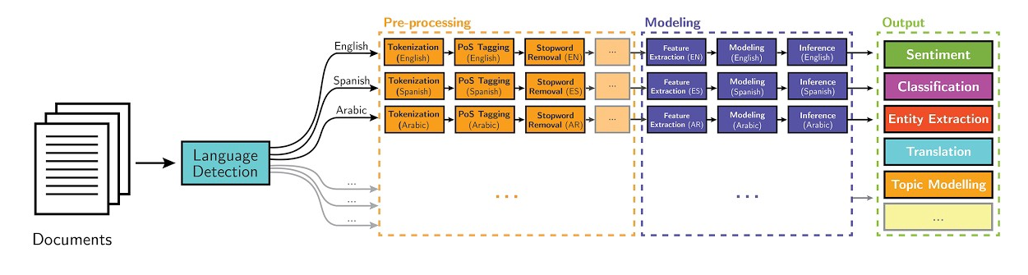
Once our data is processed, everything we have covered still applies
Notes:
Image Source: https://devopedia.org/natural-language-processing

Slide 22

Text Analytics Mechanics
-by hand to build intuition-

Slide 23
Team Challenge
(Next Session)

Slide 24

Use Text Analytics to SMS Spam
Your analytics firm was hired to monitor spam messages that are now increasingly being sent as unsolicited SMS messages.
The datasets can be found on Big Query (questrom.SMSspam). The tables are train, and test. There is also an example submission file (that you will submit as a csv file).
You should consider combining the various techniques we have covered to date (data cleaning, clustering, dimensionality reduction,etc.) and use that work in concert with whatever classification method you feel is most appropriate.
Your submission to the leaderboard will be based on the accuracy.
HINT: Start simple and work towards complexity
Notes:
http://34.85.189.70:8501/

Slide 25
Notes
label is the label, and should be modeled as a classification problem
Handle the data any way that you see fit
Use test table as the data to apply your model and score the dataset with a label of ham/spam
See the next slide for the format of your submission, which must be a csv
Use any method you want to fit the classification model

Slide 26
Tips and Tricks - What is our best, naive guess?
Don’t be afraid to start simple and try different variations.
Think about how to create columns/features from the dataset given the string of text
Don’t try to build complex workflows right away, keep it simple for faster iteration and to see if you can improve your correlation score along the way
What is our baseline assumption (naive guess)?
Each team member can try a different approach to see who is getting better accuracy score

Slide 27
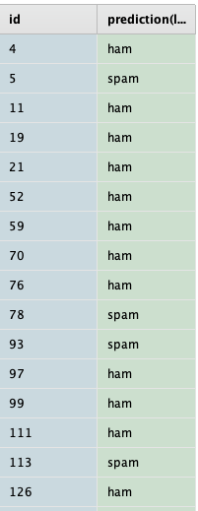
Submission CSV
Filename does not matter
Two column csv file with the id column and the predicted value as text
id
label
You can submit as many times as you like
Notice the prediction is ham/spam (string)
NOTE: when writing your csv from pandas, remember, index=False
We only want those two columns

Slide 28
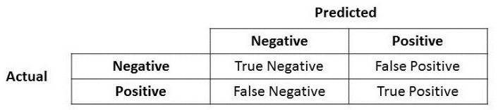
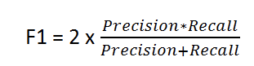
Classification Evaluation
Accuracy
What percentage of the predictions were correct?
Precision
How often were the model’s predictions accurate? TP / TP + FP
Recall
What percentage of known positive cases were correctly identified? TP / TP + FN
F1
Balance of Precision and Recall
Helpful when there is class imbalance
Notes:
https://developers.google.com/machine-learning/crash-course/classification/precision-and-recall
https://towardsdatascience.com/accuracy-precision-recall-or-f1-331fb37c5cb9

Slide 29
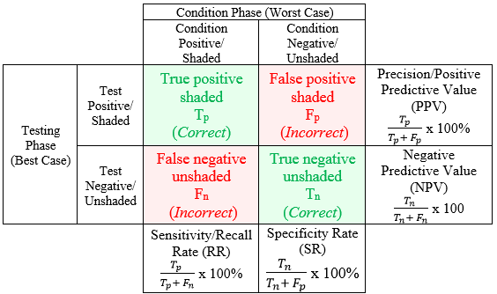
Confusion Matrix and the Core Calculations
Depending on the source, actual or predicted could be rows or columns so be careful
Green diagonal is the total correct cases. Accuracy rate is the green diagonal divided by total number of cases
Red Diagonal is the total incorrect. Misclassification rate is the red diagonal divided by the total number of cases
Actual True/Yes
Actual False/No
Predicted True/Yes
Predicted False/No
Notes:
https://www.researchgate.net/figure/Modified-Confusion-Matrix-Table-for-Accuracy-Prediction-of-24_fig4_319183193

